Slide 1


Azure SQL for Beginners Performance Troubleshooting High CPU due to a missing index
Special Edition
#azuresql
aka.ms/azuresql4beginners

Slide 2


Performance is “slow” = Running vs Waiting
Low or
no CPU
High CPU
What queries are the top resource consuming queries or are waiting?

Slide 3



Running vs Waiting Scenarios
High CPU
Waiting
Missing Index
Blocking
Anti-pattern queries
Deadlocks
Lack of resources
Memory Grants

Slide 4
The troubleshooting process
Identify High CPU
Find Top Resource Consuming Query or Queries by CPU
Look at the Query Plan
See if any indexes are missing
Create the index
Observe if performance has improved
Try it yourself at https://aka.ms/azuresqlworkshop

Slide 5
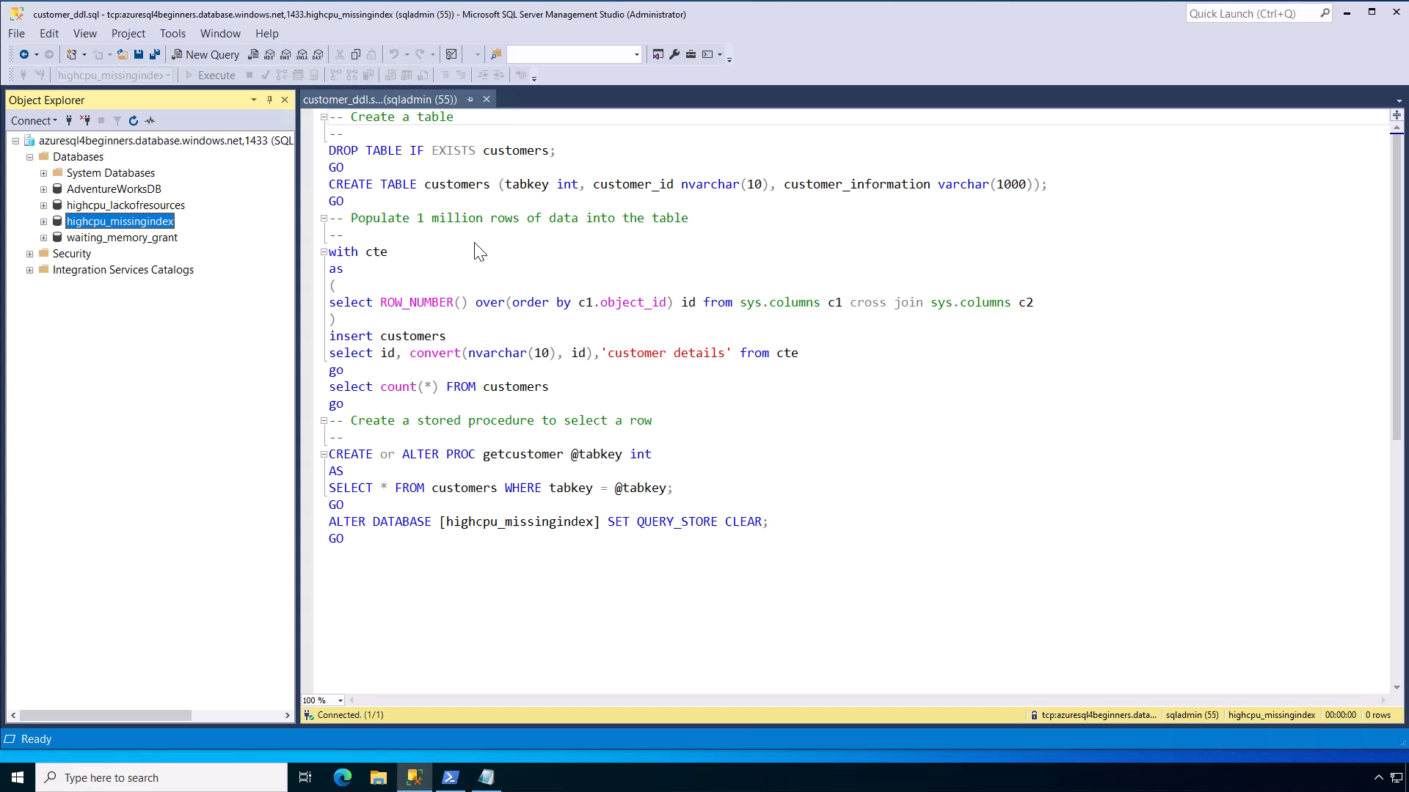
Notes:
30 secs

Slide 6
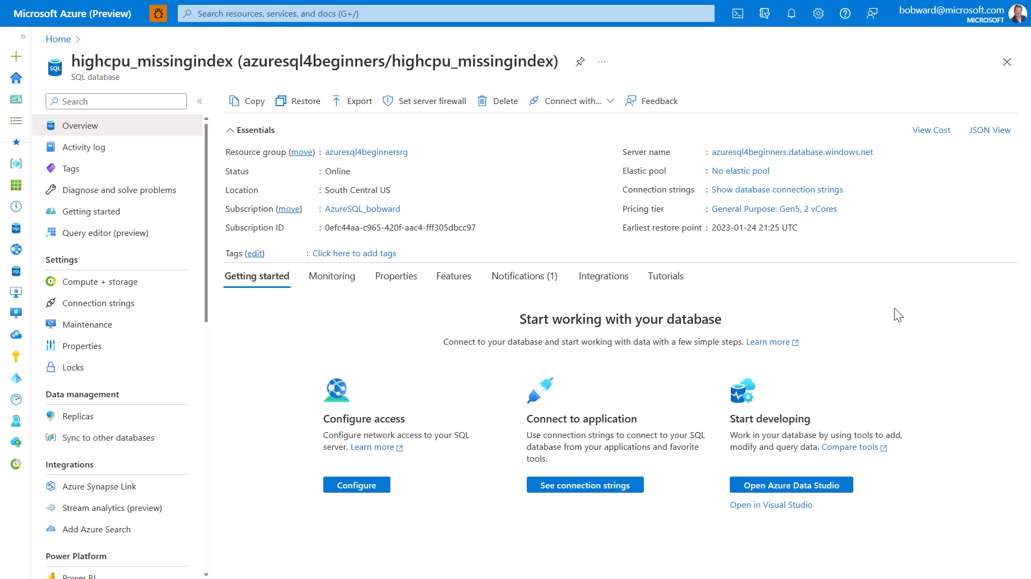
Notes:
30 seconds

Slide 7
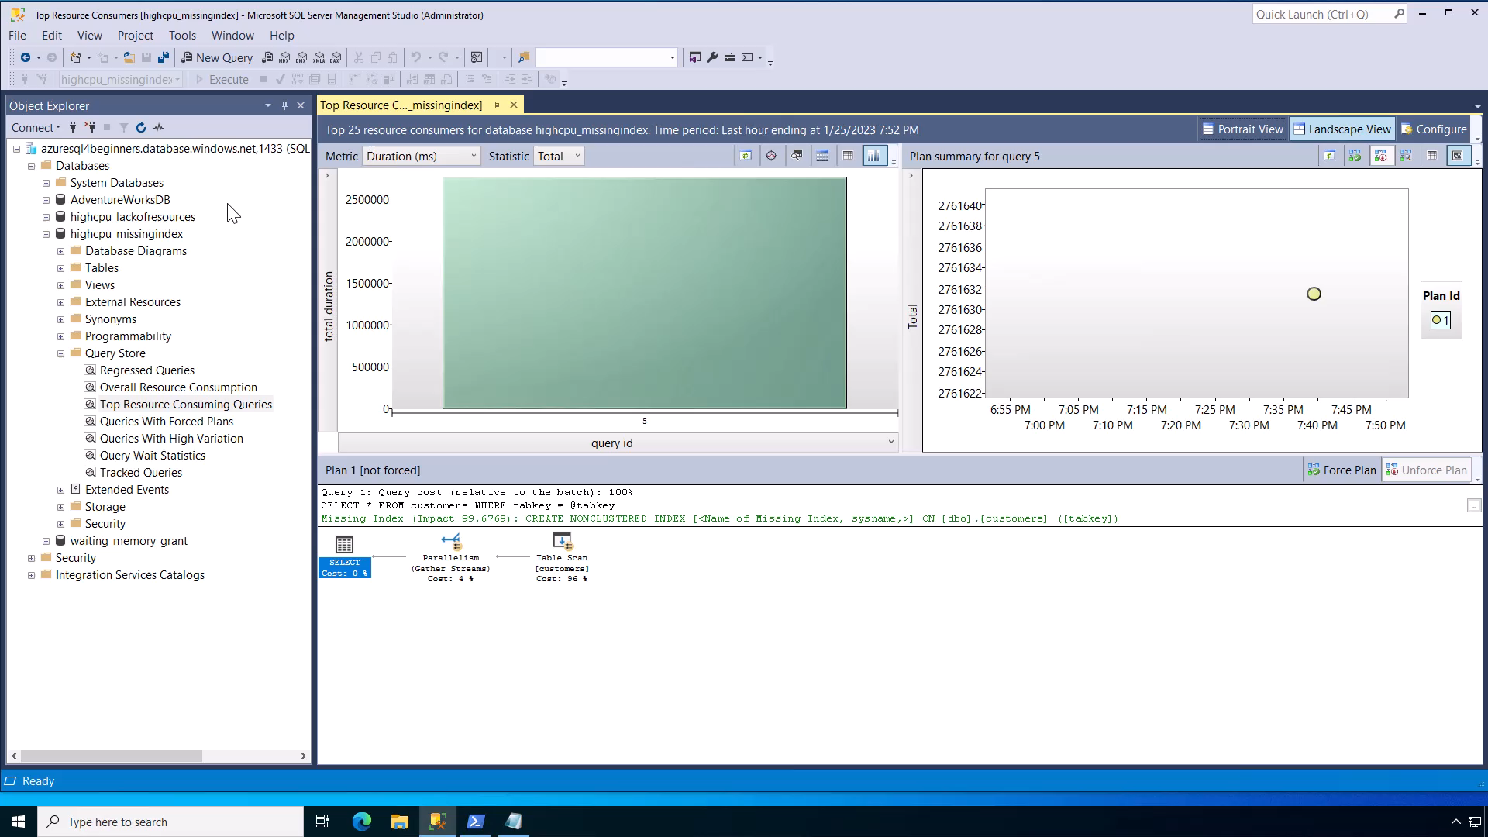
Notes:
1 min

Slide 8
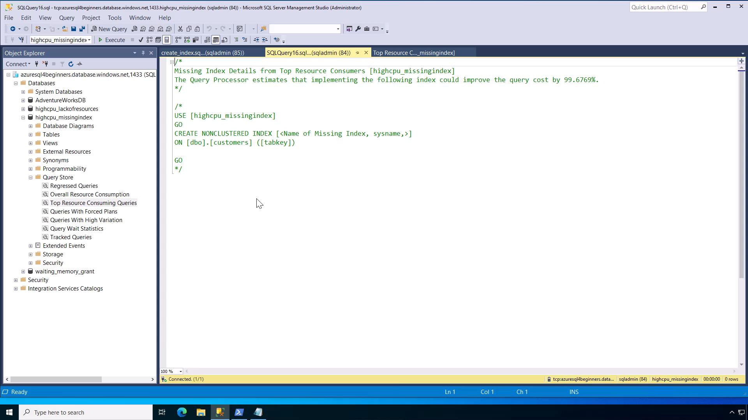
Notes:
30 secs

Slide 9
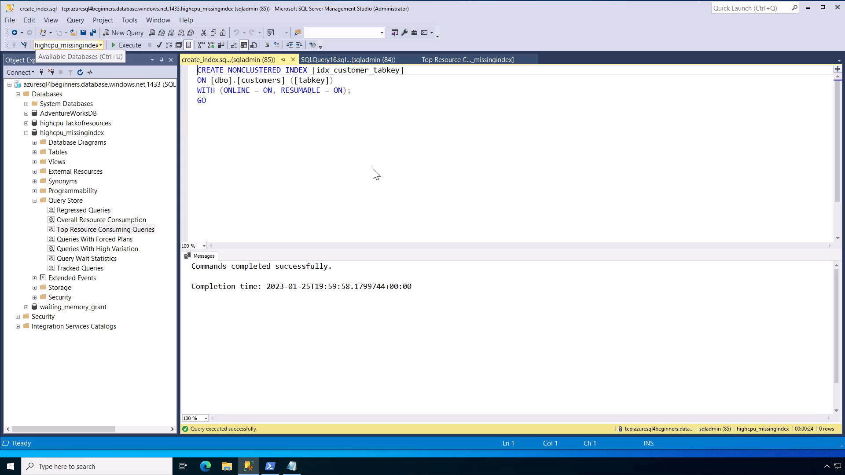
Notes:
1 min

Slide 10
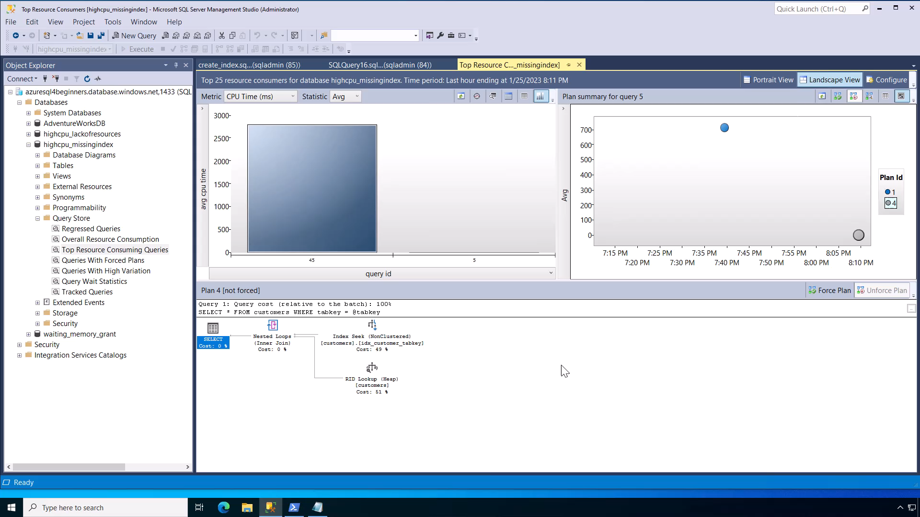
Notes:
40 secs
Demo total = ~4mins

Slide 11
Summary
SQL performance problems are either running or waiting.
SQL performance problems typically involve finding out what queries are involved.
If you identify a High CPU problem, find the top resource consuming query or queries by CPU.
Check the query plan to see if an index is missing.
Create the appropriate indexes and confirm problem is resolved.

Slide 12


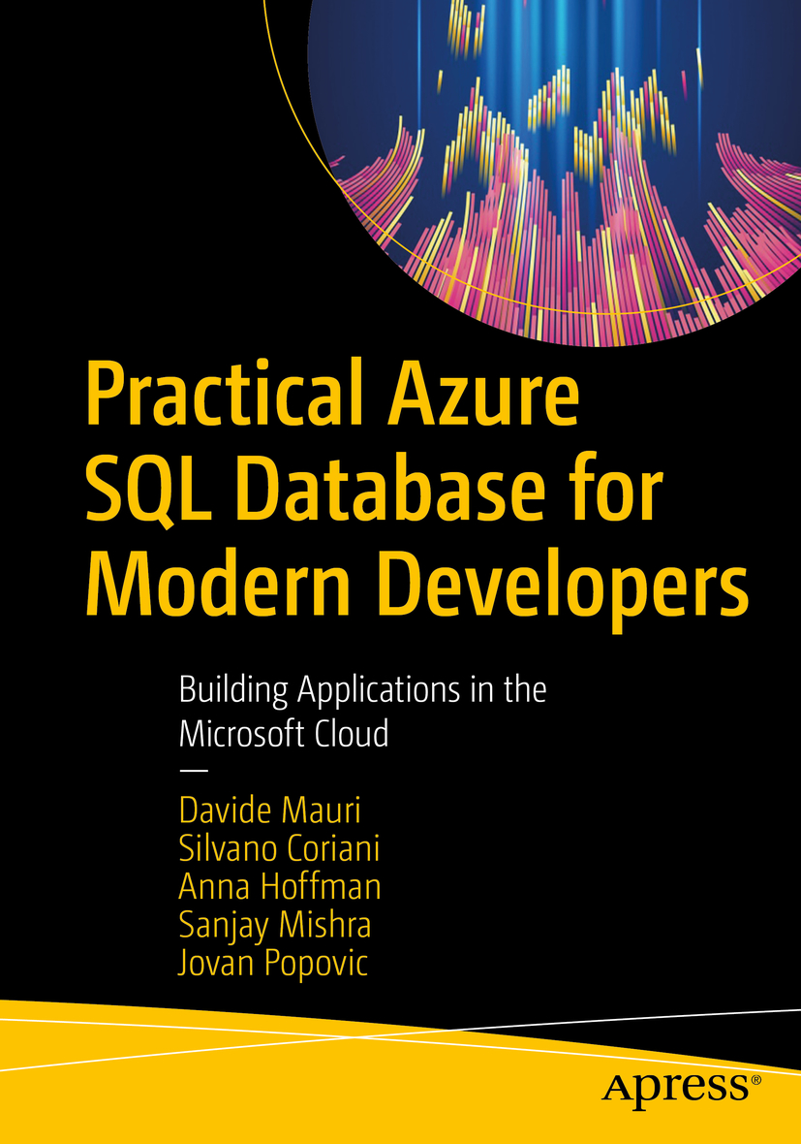


Learn more
SQL Index Design Guide
aka.ms/sqlindexes
Azure SQL for Beginners
aka.ms/azuresql4beginners
Azure SQL Workshop
aka.ms/azuresqlworkshop
aka.ms/azuresqlbook
Azure SQL Fundamentals
aka.ms/azuresqlfundamentals
Watch Data Exposed
aka.ms/dataexposed
See more videos from our team
aka.ms/azuresqlyt
Follow us on social media
aka.ms/azuresqltwitter
aka.ms/azuresqlfordevelopers

